Slide 1
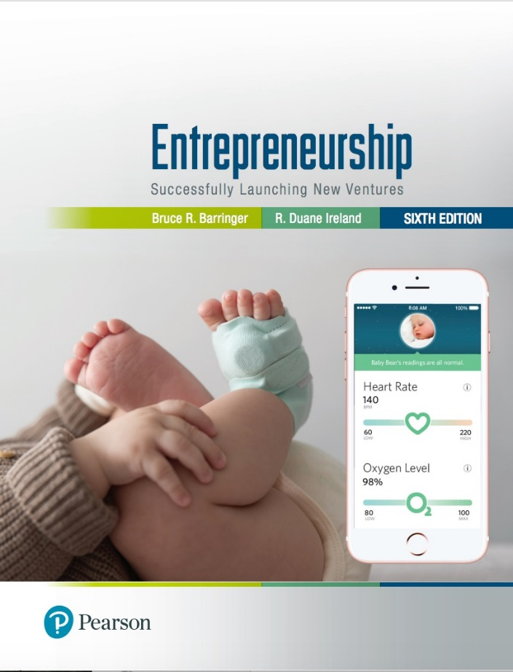
Entrepreneurship: Successfully Launching New Ventures
Sixth Edition
Chapter 10
Getting Financing or Funding
Notes:
If this PowerPoint presentation contains mathematical equations, you may need to check that your computer has the following installed:
1) MathType Plugin
2) Math Player (free versions available)
3) NVDA Reader (free versions available)

Slide 2
Learning Objectives (1 of 2)
10.1 Describe the importance of financing for entrepreneurial success.
10.2 Explain why most entrepreneurial ventures need to raise money during their early life.
10.3 Identify and describe the three sources of personal financing available to entrepreneurs.
10.4 Identify and explain the three steps involved in properly preparing to raise debt or equity financing.
10.5 Explain the three most important sources of equity funding that are available to the entrepreneurial firm.

Slide 3
Learning Objectives (2 of 2)
10.6 Describe common sources of debt financing entrepreneurial firms use.
10.7 Describe several creative sources of financing entrepreneurial firms may choose to use.

Slide 4
The Importance of Getting Financing or Funding
The Nature of the Funding and Financing Process
Few people deal with the process of raising investment capital until they need to raise capital for their own firm.
As a result, many entrepreneurs go about the task of raising capital haphazardly because they lack experience in this area.
Why Most New Ventures Need Funding
There are three reasons most new ventures need to raise money during their early life.
The three reasons are shown on the following slide.

Slide 5
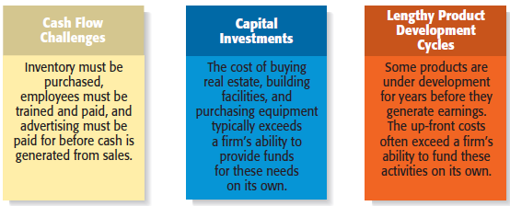
Why Most New Ventures Need Financing or Funding
Figure 10.1 Three Reasons Start-Ups Need Funding

Slide 6
Alternatives for Raising Money for a New Venture
Personal Funds
Debt Financing
Equity Capital
Creative Sources

Slide 7
Sources of Personal Financing (1 of 2)
Personal Funds
The vast majority of founders contribute personal funds, along with sweat equity, to their ventures.
Sweat equity represents the value of the time and effort that a founder puts into a new venture.
Friends and Family
Friends and family are the second source of funds for many new ventures.

Slide 8
Sources of Personal Financing (2 of 2)
Bootstrapping
A third source of seed money for a new venture is referred to as bootstrapping.
Bootstrapping is finding ways to avoid the need for external financing or funding through creativity, ingenuity, thriftiness, cost cutting, or any means necessary.
Many entrepreneurs bootstrap out of necessity.

Slide 9
Examples of Bootstrapping Methods (1 of 2)
Buy used instead of new equipment.
Coordinate purchases with other businesses.
Lease equipment rather than buying.
Obtain payments in advance from customers.
Minimize personal expenses.
Avoid unnecessary expenses, such as lavish office space or furniture.

Slide 10
Examples of Bootstrapping Methods (2 of 2)
Buy items cheaply, but prudently, through discount outlets or online auctions such as eBay, rather than at full-price stores.
Share office space or employees with other businesses.
Hire interns.

Slide 11
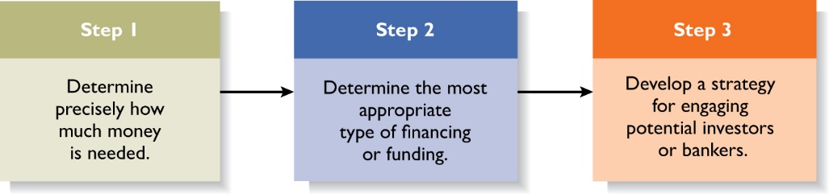
Preparing to Raise Debt or Equity Financing (1 of 3)
Figure 10.3 Preparation for Debt or Equity Financing

Slide 12
Preparing to Raise Debt or Equity Financing (2 of 3)
Two Most Common Alternatives
Equity Funding
Means exchanging partial ownership in a firm, usually in the form of stock, for funding.
Debt Financing
Is getting a loan.

Slide 13
Preparing to Raise Debt or Equity Financing (3 of 3)
Table 10.2 Matching an Entrepreneurial Venture’s Characteristics with the Appropriate Form of Financing or Funding
Characteristics of the Venture | Appropriate Source of Financing or Funding
The business has high risk with an uncertain return: Weak cash flow High leverage Low-to-moderate growth Unproven management | Personal funds, friends, family, and other forms of bootstrapping
The business has low risk with a more predictable return: Strong cash flow Low leverage Audited financials Good management Healthy balance sheet | Debt financing
The business offers a high return: Unique business idea High growth Niche market Proven management | Equity

Slide 14
Preparing an Elevator Speech (1 of 2)
Purpose
An elevator speech is a brief, carefully constructed statement that outlines the merits of a business opportunity.
There are many occasions when a carefully constructed elevator speech might come in handy.
Most elevator speeches are around 60 seconds long.

Slide 15
Preparing an Elevator Speech (2 of 2)
Table 10.3 Guidelines for Preparing an Elevator Speech
Step 1 | Describe the opportunity or problem that needs to be solved. | 20 seconds
Step 2 | Describe how your product meets the opportunity or solves the problem. | 20 seconds
Step 3 | Describe your qualifications. | 10 seconds
Step 4 | Describe your market. | 10 seconds
Total | blank | 60 seconds

Slide 16
Sources of Equity Funding
Business Angels
Venture Capital
Initial Public Offerings

Slide 17
Business Angels (1 of 4)
Are individuals who invest their personal capital directly in start-ups.
The prototypical business angel is about 50 years old, has high income and wealth, is well educated, has succeeded as an entrepreneur, and invests in companies that are in the region where he or she lives.
Angel investors generally invest between $10,000 and $500,000 in a single company and are looking for companies that have the potential to grow 30 to 40 percent per year before they are acquired or go public.

Slide 18
Business Angels (2 of 4)
Many well-known companies, including Apple and Google, received their initial investment from one or more angel investors.
The number of angel investors in the United States, which is estimated to be around 304,900, has increased dramatically over the past decade.
Many angels are motivated by more than financial returns: they enjoy the process of mentoring a new start-up.

Slide 19
Business Angels (3 of 4)
Most angel investors remain fairly anonymous and are matched up with entrepreneurs via referrals.
To find a business angel, an entrepreneur should discreetly work his/her network of acquaintances to see if anyone can make an appropriate introduction.
An advantage that college students have in regard to finding business angels is that many judge college or university-sponsored business plan or business model competitions.

Slide 20
Business Angels (4 of 4)
There are organized groups of business angels.
These groups typically consist of 10 to 150 angel investors in a local area that meet regularly to listen to business plan presentations.
An example of an angel group is the Central Texas Angel Network (CTAN) located in Austin, TX.
It is a relatively large angel group, with 165 angel investors with expertise in multiple sectors.
The process the network follows to vet investment opportunities is explained on its Web site.

Slide 21
Venture Capital (1 of 6)
Venture capital is money that is invested by venture capital firms in start-ups and small businesses with exceptional growth potential.
A distinct difference between angel investors and venture capital firms is that angels tend to invest earlier in the life of a company, whereas venture capitalists come in later.
The majority of venture capital money goes to follow-on funding for businesses that were originally funding by angel investors, government programs, or by some other means.

Slide 22
Venture Capital (2 of 6)
Venture capital firms are limited partnerships of money managers who raise money in “funds” to invest in start-ups and growing firms.
The funds, or pools of money, are raised from high-net-worth individuals, pension plans, university endowments, foreign investors, and similar sources.
The investors who invest in venture capital funds are called limited partners. The venture capitalists are called general partners.

Slide 23
Venture Capital (3 of 6)
Because in the past venture capitalists have funded high-profile successes such as Google, Facebook, Snap, and Twitter, the industry receives a great deal of attention.
In fact, venture capitalists fund less than 1 percent of new firms.
Many entrepreneurs become discouraged when they are repeatedly rejected for venture capital funding, even though they may have an excellent business plan.
Venture capitalists are looking for the “home run.” The result is that they do not fund the majority of the business plans they receive and review.

Slide 24
Venture Capital (4 of 6)
Still, for firms that qualify, venture capital is a viable alternative to equity funding.
An advantage to obtaining this funding is that venture capitalists are extremely well-connected in the business world and can offer a firm considerable assistance beyond funding.
An important part of obtaining venture capital funding is going through the due diligence process, which refers to the process of investigating the merits of a potential venture and verifying the key claims made in the business plan.

Slide 25
Venture Capital (5 of 6)
Firms that prove to be suitable for venture capital funding should conduct their own due diligence to make sure they end up with a venture capital firm that is a good fit.
They should ask the following questions before accepting funds from a particular venture capital firm.
Do the venture capitalists have experience in our industry?
Do they take a highly active or passive management role?
Are the personalities on both sides of the table compatible?

Slide 26
Venture Capital (6 of 6)
They should ask the following questions before accepting funds from a particular venture capital firm (continued):
Does the firm have deep enough pockets or sufficient contacts within the venture capital industry to provide follow-on rounds of financing?
Is the firm negotiating in good faith in regard to the percentage of our firm they want in exchange for their investment?

Slide 27
Initial Public Offering (1 of 3)
An initial public offering (IPO) is a company’s first sale of stock to the public. When a company goes public, its stock is traded on one of the major stock exchanges.
Most entrepreneurial firms that go public trade on the NASDAQ, which is weighted heavily toward technology, biotech, and small-company stocks.
An IPO is an important milestone for a firm. Typically, a firm is not able to go public until it has demonstrated that it is viable and has a bright future.

Slide 28
Initial Public Offering (2 of 3)
Reasons that Motivate Firms to Go Public
Reason 1
Is a way to raise equity capital to fund current and future operations.
Reason 2
Raises a firm’s public profile, making it easier to attract high-quality customers and business partners.

Slide 29
Initial Public Offering (3 of 3)
Reasons that Motivate Firms to Go Public
Reason 3
Is a liquidity event that provides a means for a company’s investors to recoup their investments.
Reason 4
Creates a form of currency that can be used to grow the company via acquisitions.

Slide 30
Sources of Debt Financing
Commercial Banks
SBA Guaranteed Loans

Slide 31
Commercial Banks (1 of 2)
Historically, commercial banks have not been viewed as a practical source of financing for start-up firms.
This sentiment is not a knock against banks; it is just that banks are risk averse, and financing start-ups is a risky business.
Banks are interested in firms that have a strong cash flow, low leverage, audited financials, good management, and a healthy balance sheet.
Although many new ventures have good management, few have the other characteristics, at least initially.

Slide 32
Commercial Banks (2 of 2)
The good news is that despite these historical precedents, some banks are starting to engage start-up entrepreneurs.
When it comes to start-ups, some banks are rethinking their lending standards and are beginning to focus on cash flow and the strength of the management team rather than on collateral and the strength of the balance sheet.
Entrepreneurs should follow developments in this area closely.

Slide 33
SBA Guaranteed Loans (1 of 2)
The SBA Guaranteed Loan Program
The most notable SBA program available to small businesses is the 7(A) Guaranty Program.
The program operates through private-sector lenders who provide loans that are guaranteed by the SBA.
The loans are for small businesses that are unable to secure financing on reasonable terms through normal lending channels.
Almost all businesses are eligible to apply for and SBA loan.

Slide 34
SBA Guaranteed Loans (2 of 2)
Size and Types of Loans
The SBA can guarantee as much as 85% on loans up to $150,000 and 75% on loans for more than $150,000.
An SBA guaranteed loan can be used for almost any legitimate business purpose.
Although SBA guaranteed loans are utilized more heavily by existing small businesses than start-ups, they should not be dismissed as a possible source of financing.

Slide 35
Other Sources of Debt Financing (1 of 3)
Online Lenders
There is a group of online lenders, including OnDeck, Kabbage, and BlueVine that provide loans to businesses.
Depending on the company, loans are available from $2,000 to $2 million.
Interest rates are normally higher than charged by a commercial bank, so it is advisable to check the terms carefully.

Slide 36
Other Sources of Debt Financing (2 of 3)
Peer-to-Peer Lenders
Peer-to-peer lenders underwrite borrowers but don’t fund the loans directly.
Instead, they act as intermediaries between borrowers and individuals or borrowers and institutional investors.
Funding Circle and Lending Club are examples of peer-to-peer lenders.
The thing to watch when considering peer-to-peer loans is the annual percentage rate, which in many cases is high.

Slide 37
Other Sources of Debt Financing (3 of 3)
Vendor Credit
Also known as trade credit, is when a vendor extends credit to a business in order to allow the business to buy its products and/or services up front but defer payment until later.
Factoring
Is a financial transaction whereby a business sells its accounts receivable to a third party, called a factor, at a discount in exchange for cash.

Slide 38
Creative Sources of Financing or Funding
Crowdfunding
Leasing
SBIR and STTR Grant Programs
Other Grant Programs
Strategic Partners

Slide 39
Crowdfunding (1 of 2)
Crowdfunding is the practice of funding a project or new venture by raising monetary contributions from a large number of people (the “crowd”) typically via the Internet.
Two Types of Crowdfunding Programs
Rewards-based crowdfunding allows entrepreneurs to raise money in exchange for some type of amenity or reward.
Kickstarter and Indiegogo are the most popular rewards-based crowdfunding sites.

Slide 40
Crowdfunding (2 of 2)
Equity-based crowdfunding helps businesses raise money by tapping individuals and investors who provide funding in exchange for equity in the business.
The catalyst for the advent of equity-based crowdfunding was the JOBS Act, which was passed in April 2012.
Four of the most popular equity-based crowdfunding sites are MicroVentures, Fundable, Crowdfunder, and CircleUp.
Equity-based crowdfunding is gaining momentum. Over $85 million has been invested through MicroVentures since 2009.

Slide 41
Leasing (1 of 2)
A lease is a written agreement in which the owner of a piece of property allows an individual or business to use the property for a specified period of time in exchange for payments.
The major advantage of leasing is that it enables a company to acquire the use of assets with very little or no down payment.
Leases for facilities and leases for equipment are the two most common types of leases that entrepreneurial ventures undertake.

Slide 42
Leasing (2 of 2)
Most leases involve a modest down payment and monthly payments during the duration of the lease.
At the end of an equipment lease, the new venture typically has the option to stop using the equipment, purchase it for fair market value, or renew the lease.
Leasing is almost always more expensive than paying cash for an item, so most entrepreneurs think of leasing as an alternative to equity or debt financing.

Slide 43
SBIR and STTR Grants (1 of 5)
SBIR and STTR Programs
The Small Business Innovation Research (SBIR) and the Small Business Technology Transfer (STTR) programs are two important sources of early-stage funding for technology firms.
These programs provide cash grants to entrepreneurs who are working on projects in specific areas.
The main difference between the SBIR and the STTR programs is that the STTR program requires the participation of researchers working at universities or other research institutions.

Slide 44
SBIR and STTR Grants (2 of 5)
SBIR Program
The SBIR Program is a competitive grant program that provides over $2.5 billion per year to small businesses for early-stage and development projects.
Each year, 11 federal departments and agencies are required by the SBIR to reserve a portion of their R&D funds for awards to small businesses.
Guidelines for how to apply for the grants are provided on each agency’s Web site.

Slide 45
SBIR and STTR Grants (3 of 5)
SBIR Program (continued)
The SBIR is a three-phase program, meaning that firms that qualify have the potential to receive more than one grant to fund a particular proposal.
Historically, less than 15% of all Phase I proposals are funded. The payoff for successful proposals, however, is high.
The money is essentially free. It is a grant, meaning that it doesn’t have to be paid back and no equity in the firm is at stake.
The small business receiving the grant also retains the rights to any intellectual property generated as the result of the grant initiative.

Slide 46
SBIR and STTR Grants (4 of 5)
SBIR Three-Phase Grant Program
Table 10.5 Small Business Innovation Research: Three-Phase Program
Phase | Purpose of Phase | Duration | Funding Available (Varies by Agency)
Phase I | To demonstrate the proposed innovation’s technical feasibility. | Up to 6 months | Up to $150,000
Phase II | Available to successful Phase I companies. The purpose of a Phase II grant is to develop and test a prototype of the innovation validated in Phase I. | Up to 2 years | Up to $1 million
Phase III | Period in which Phase II innovations move from the research and development lab to the marketplace. | Open | No SBIR funding available; however, federal agencies may award non-SBIR-funded follow-on grants or contracts for products or processes that meet the mission needs of those agencies, or for further R&D.

Slide 47
SBIR and STTR Grants (5 of 5)
STTR Program
Is a variation of the SBIR for collaborative research projects that involve small businesses and research organizations, such as universities or federal labs.
The STTR program requires the company to have a partnering research institution.
More information about the SBIR and STTR can be obtained at www.sbir.gov.

Slide 48
Other Grant Programs
Private Grants
There are a limited number of grant programs available to entrepreneurs.
Getting grants takes a little detective work.
Granting agencies are low key, and must be sought out.
Other Government Grants
The federal government has grant programs beyond the SBIR and STTR programs.
The full spectrum of grants available is listed at www.grants.gov.
Be careful of grant-related scams.

Slide 49
Strategic Partners
Strategic partners are another source of capital for new ventures.
Many partnerships are formed to share the costs of product or service development, to gain access to particular resources, or to facilitate speed to market.
Strategic partnerships that capture these types of benefits can help new ventures lessen their need for funding or financing.

Slide 50

Copyright

